Slide 1
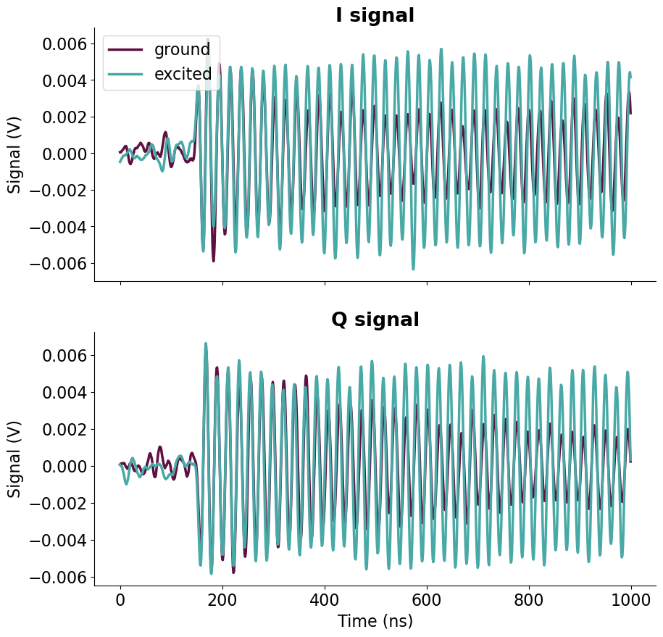
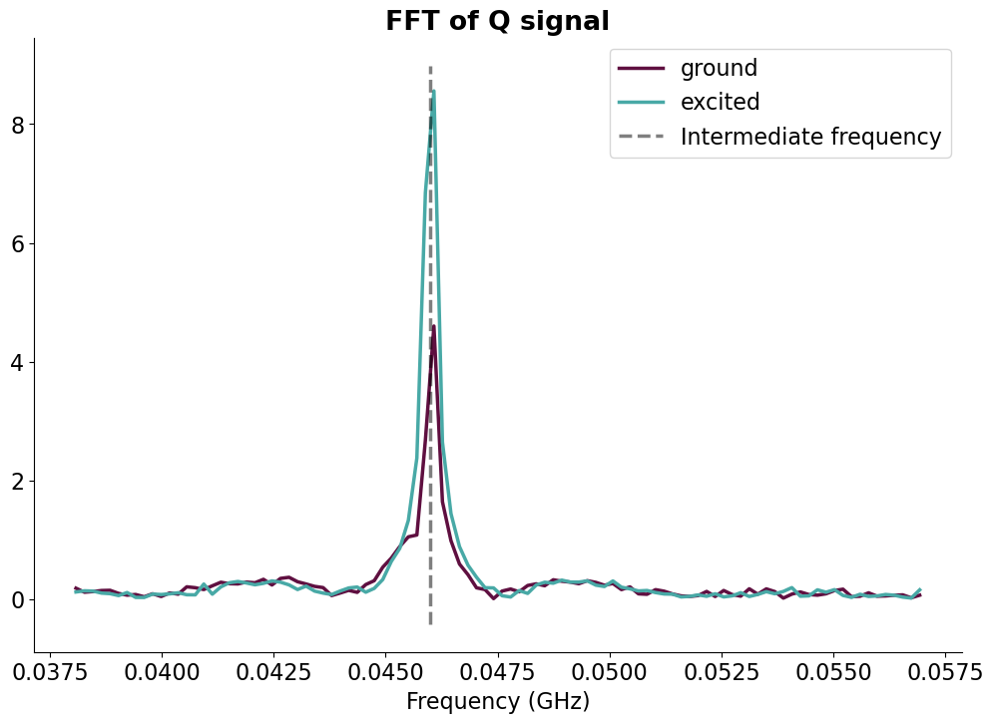
Group Meeting Update 26/4-23
Johann Bock Severin
Time Trace Data

Slide 2
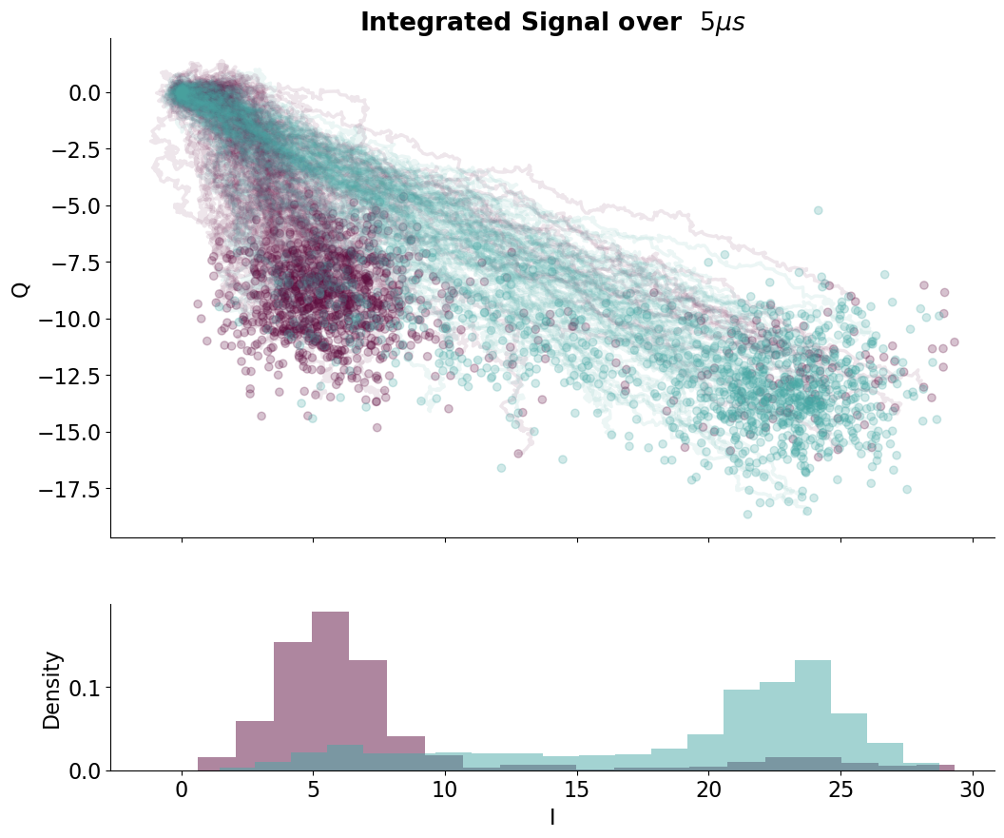
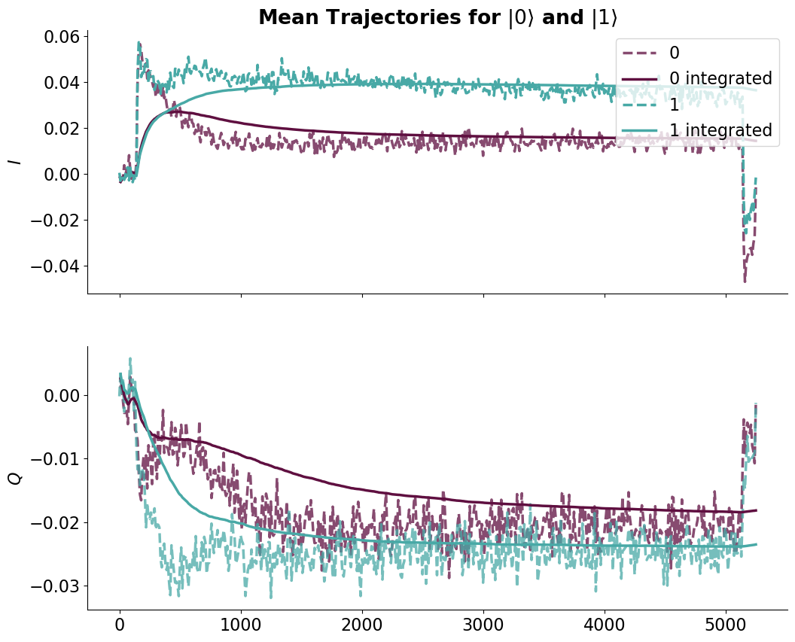
Group Meeting Update 26/4-23
Johann Bock Severin
Time Trace Data from T5

Slide 3
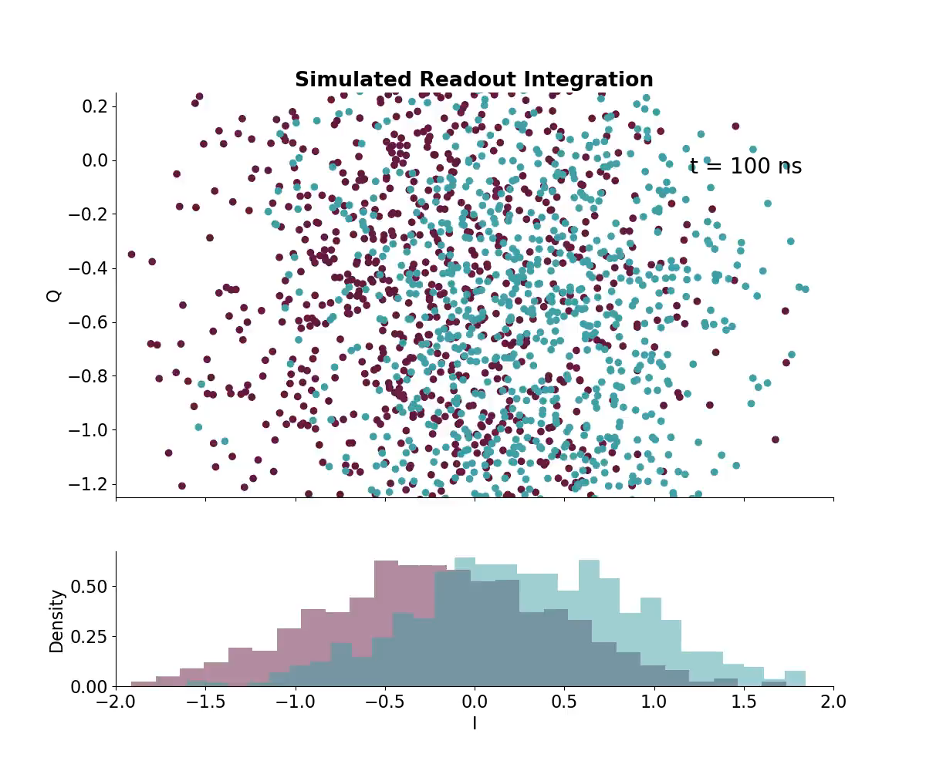
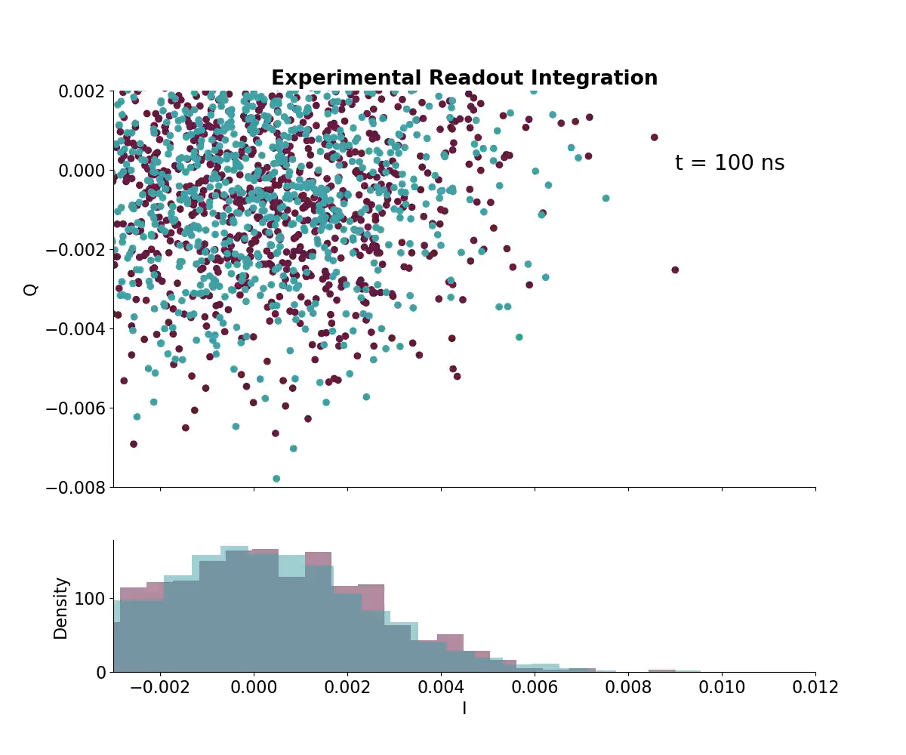
Group Meeting Update 26/4-23
Johann Bock Severin

Slide 4
Group Meeting Update 26/4-23
Johann Bock Severin
What can we use this for?

Slide 5
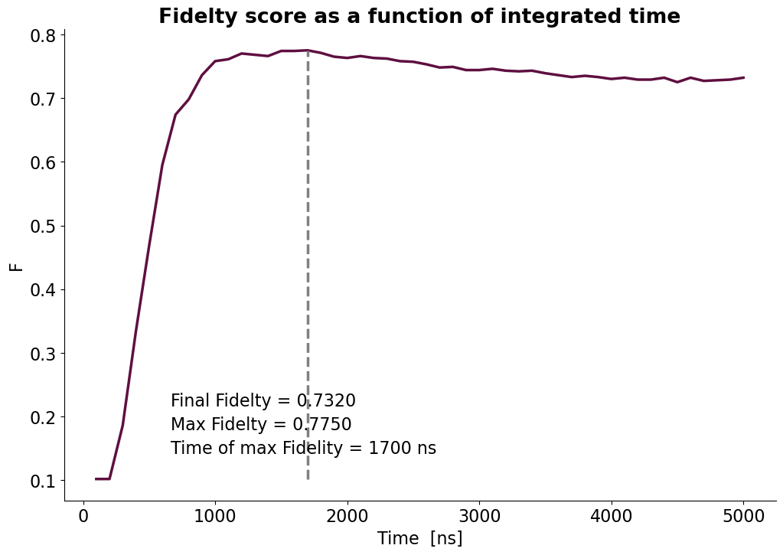
Group Meeting Update 26/4-23
Johann Bock Severin
What can we use this for?
Time-optimizing Readout Fidelity and Strategies

Slide 6
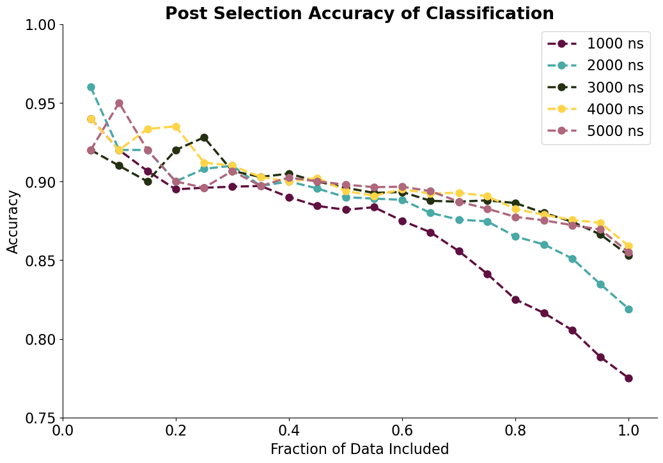
Group Meeting Update 26/4-23
Johann Bock Severin
What can we use this for?
Time-optimizing Readout Fidelity and Strategies
Post Selection

Slide 7
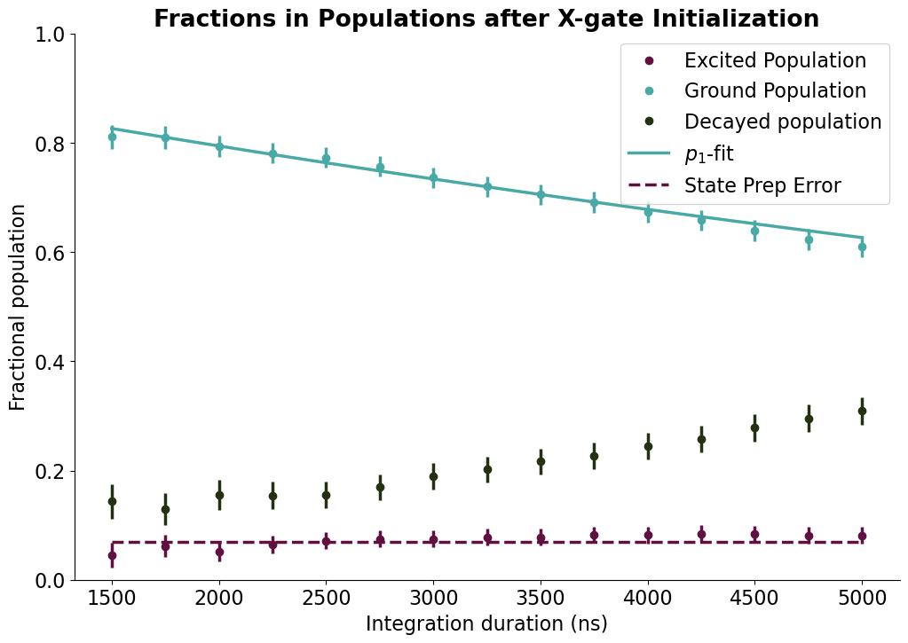
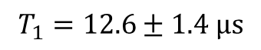
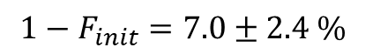
Group Meeting Update 26/4-23
Johann Bock Severin
What can we use this for?
Time-optimizing Readout Fidelity and Strategies
Post Selection
SPAM Separation
$$T_{1}=12.6±1.4 μs$$
$$1−F_{init}=7.0±2.4 \%$$

Slide 8
Group Meeting Update 26/4-23
Johann Bock Severin
What can we use this for?
Time-optimizing Readout Fidelity and Strategies
Post Selection
SPAM Separation
Other ideas are welcome

